Slide 1
OpenEBench: the ELIXIR benchmarking platform
Laura Portell (laura.portell@bsc.es)
Asier Gonzalez (asier.gonzalez@bsc.es)
Jose Maria Fernandez (jose.m.fernandez@bsc.es)
Laura Rodriguez-Navas (laura.rodriguez@bsc.es)
Barcelona Supercomputing Center (BSC), ELIXIR-ES
30-11-2021, ELIXIR Workflow Workshop

Slide 2

Index
Why benchmarking?
OpenEBench approach to reproducible benchmarking
OpenEBench platform
Levels of engagement
OpenEBench benchmarking process
Hands-on exercise 1
WfExS: A workflow execution service
How does WfExS fit in OpenEBench?
RO-Crate and WorkflowHub
Hands-on exercise 2

Slide 3


Slide 4

Community-driven benchmarking
Face similar challenges and want to collaborate for advancing in the understanding of specific scientific problems.
Guarantees a more complete benchmarking.
Useful for a wider group of people: software developers and users.
Follows the principles of Open Science to foster reproducibility, data sharing...

Slide 5
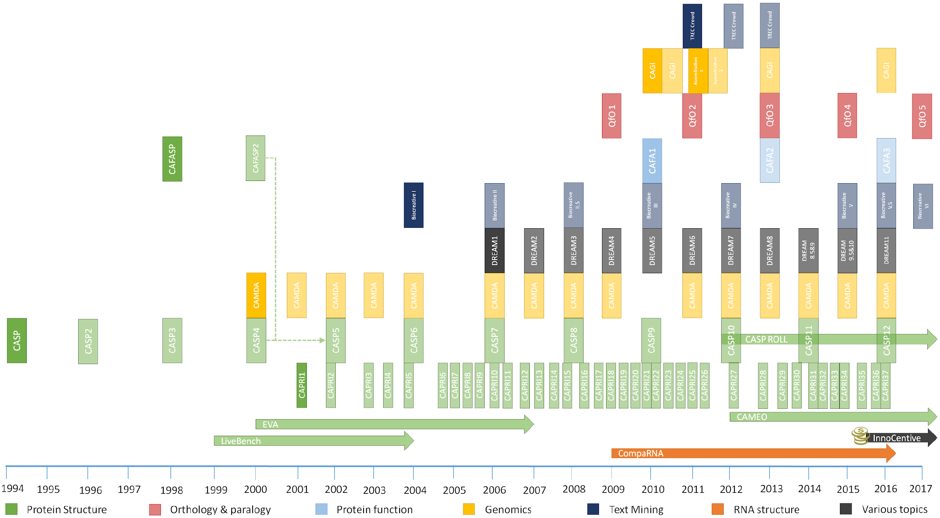
Standing on the shoulders of giants ...
Lessons Learned: Recommendations for Establishing Critical Periodic Scientific Benchmarking.
Capella-Gutierrez S … Gelpi JL, Valencia A. bioRxiv 181677; 10.1101/181677

Slide 6


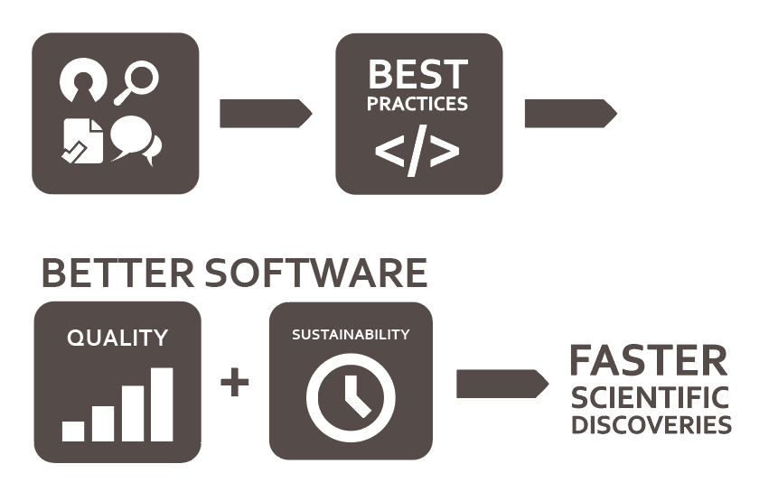
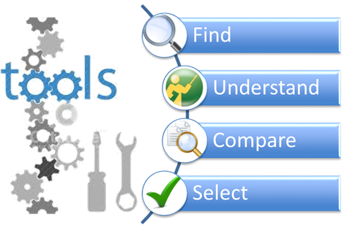
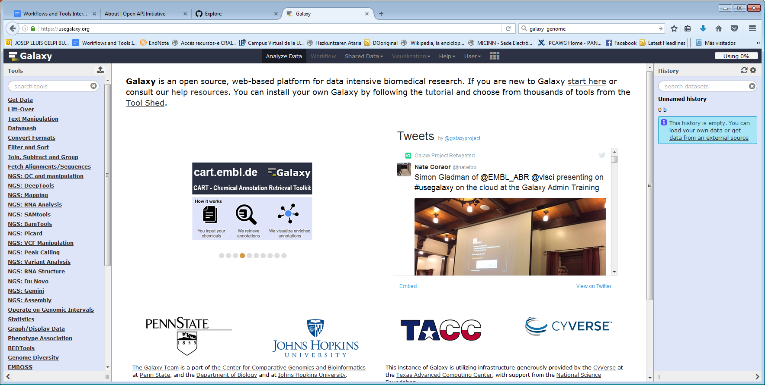
The ELIXIR Tools Platform
To support efforts around software packaging & containers, e.g. Bioconda/ BioContainers, and support sustainable integration into bio.tools and OpenEBench
bio.tools, a discovery portal for bioinformatics software information, providing curated description of tools and data services
OpenEBench, an infrastructure providing services for hosting scientific benchmark activities and technical monitoring of bioinformatics tools and services
T
To drive the development of execution platforms (e.g. Galaxy) and ensure integration with bio.tools, OpenEBench, and workflows using CWL
Raise software quality and sustainability, by producing and promoting software best practices and developing training activities
Tools Interoperability, guidelines and resources for guaranteeing Platforms integration within the ELIXIR Tools Platform Ecosystem, with other Platforms in ELIXIR and beyond.
Notes:
If you haven’t heard about OpenEBench before, it is part of the ELIXIR tools platform alongside other well-known repositories and platforms such as biocontainers, bio.tools and Galaxy. As such, it is developed following guidelines to guarantee its integration in the ELIXIR Tools Platform Ecosystem and other ELIXIR platforms.
OpenEBench is an infrastructure that provides services for hosting scientific benchmarking events and monitors bioinformatics tools and services.

Slide 7
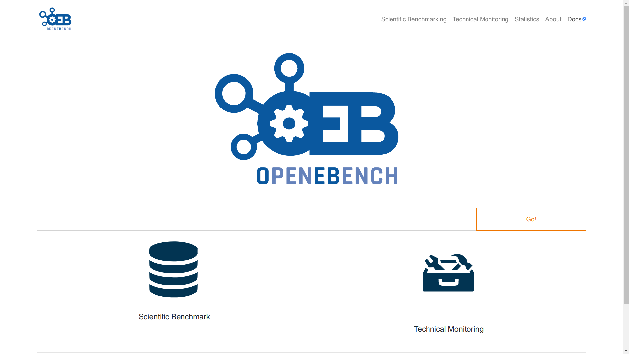
https://openebench.bsc.es

Slide 8


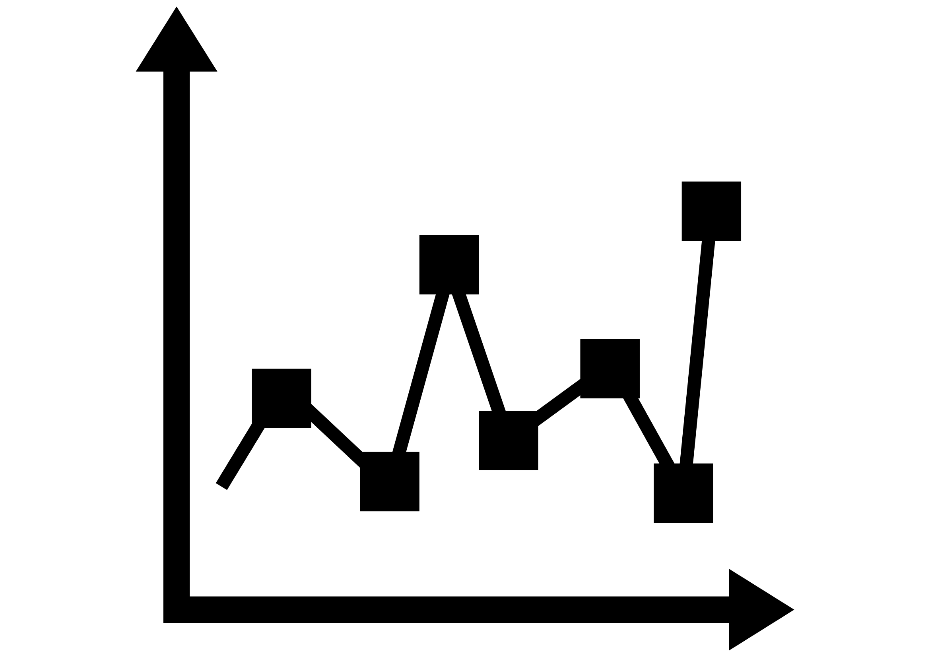

Scientific benchmarking in OpenEBench
Datasets
Evaluation Metrics
Results Interpretation

Slide 9
Scientific benchmarking in OpenEBench
How OpenEBench is organized
Community
Benchmarking Event
Challenge
Participant
Notes:
Community:The organised group behind the benchmarking.
Benchmarking Event: Time-bound contest where a tool, pipeline, service or product, i.e. The participant, is compared against other participants using a predefined collection of reference datasets and assessment metrics.
Challenge: Each of the categories in which a benchmarking event is divided. In its simplest form, one challenge comprises one reference dataset and one or more evaluation metrics. This can be customised if needed.
Participant: Software application (program, server or pipeline) evaluated within a benchmarking event in at least one challenge. The same program can participate multiple times if various versions or parameter settings are benchmarked separately.

Slide 10
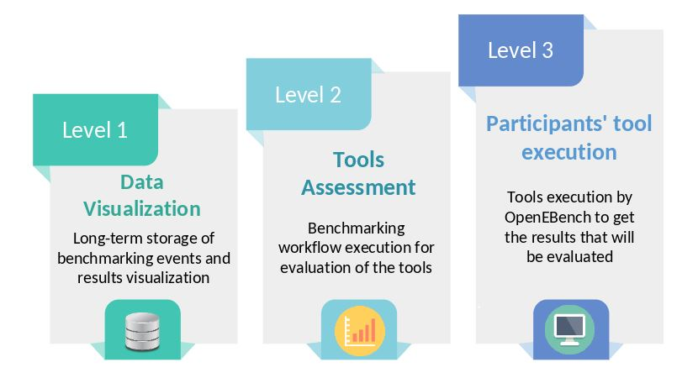
Levels of engagement
Scientific benchmarking in OpenEBench

Slide 11
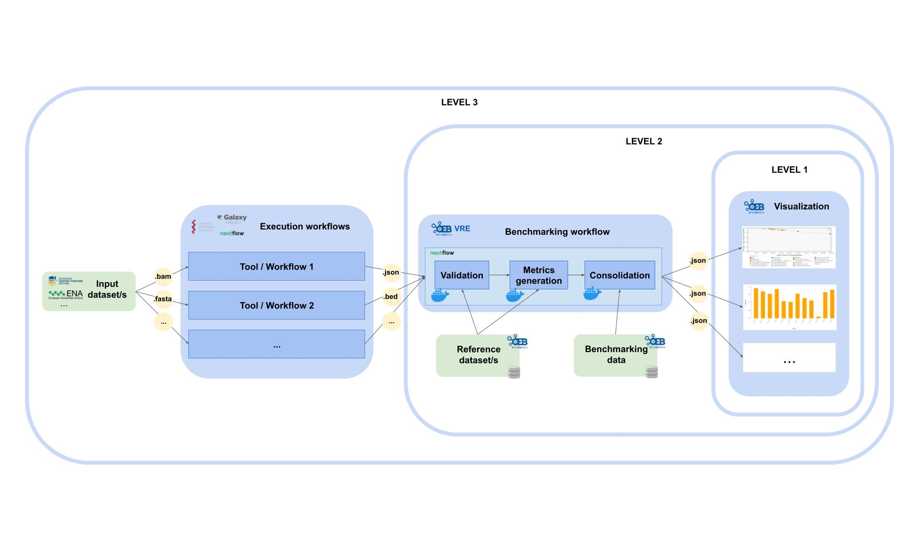
Benchmarking process
Scientific benchmarking in OpenEBench

Slide 12
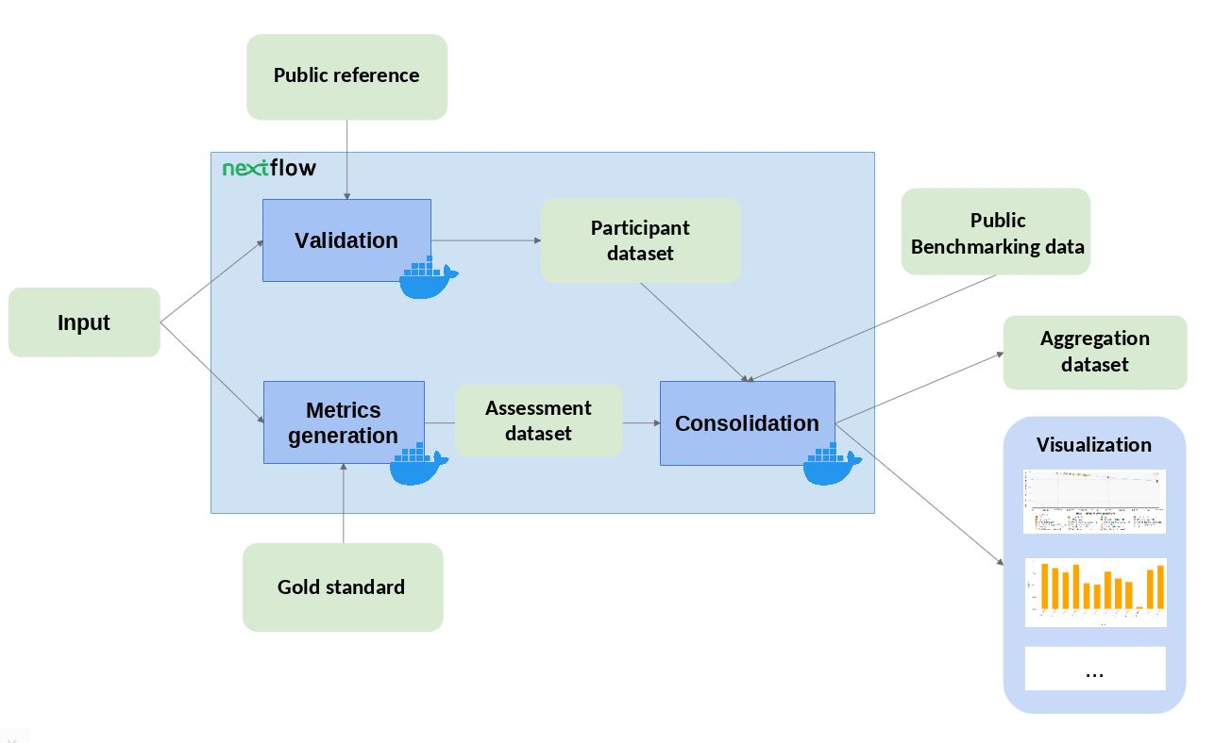
Benchmarking workflow
Scientific benchmarking in OpenEBench
https://github.com/inab/TCGA_benchmarking_workflow
https://github.com/inab/TCGA_benchmarking_dockers
Notes:
The benchmarking workflow structure is composed by three docker images / steps:
Validation: the input file format is checked and, if required, the content of the file is validated. The validation generates a participant dataset. In order to create datasets with structure compatible with the Elixir Benchmarking Data Model, the following python module and JSON schema should be used.
Metrics_computation: the predictions are compared with the ‘Gold Standards’ provided by the community using the metrics provided by the community. Precision (Positive Predictive Value) an Recall (True Positive Rate) are common ones. Those metrics are written into assessment datasets.
Consolidation: the benchmark itself is performed by merging the assessment metrics with the rest of community’s data. The results are provided in SVG format - scatter plot, and JSON format - aggregation/summary datasets, which are also compatible with the Elixir Benchmarking Data Model.

Slide 13
HANDS-ON EXERCISE 1
Running the TCGA benchmarking workflow

Slide 14
TCGA Cancer Driver Genes benchmarking description
The Cancer Genome Atlas consortium organized a benchmarking event to compare the performance of cancer driver gene identification tools in 33 cancer types [see Bailey et al, 2018 for more info]
8 tools have published their results in OpenEBench [OEBC001]
You have a tool called “my gene predictor” and want to compare the results against the public ones

Slide 15
TCGA Cancer Driver Genes benchmarking organization
Community
The Cancer Genome Atlas (TCGA)
Benchmarking Event
2018 PanCancer data - Driver Genes prediction benchmark
Challenge
Adrenocortical Carcinoma (ACC)
Breast Invasive Carcinoma (BRCA)
Participant
my_gene_predictor

Slide 16
Running the workflow from the CLI
For detailed information please refer to the README in the workflow’s GitHub repository
Requirements:
Git
Docker
Nextflow ≥ 19.10.0 (it requires Bash ≥ 3.2 and Java ≥ 8 and ≤ 17 )
Download version 1.0,8 of the workflow from GitHub:
> git clone https://github.com/inab/TCGA_benchmarking_workflow.git
> cd TCGA_benchmarking_workflow/
> git checkout 1.0.8 -b 1.0.8

Slide 17
TCGA Cancer Driver Genes benchmarking workflow
TCGA_sample_data/public_ref/public_ref.txt
1
sample_out/benchmarking_data_model_export/Participant_assessments.json
TCGA_sample_data/All_Together.txt
2
sample_out/results/ACC/ sample_out/results/BRCA/
TCGA_sample_data/metrics_ref_datasets/ACC.txt
TCGA_sample_data/metrics_ref_datasets/BRCA.txt
sample_out/participant_out/validated-participant-data.json
sample_out/assessment_out/Assessment_datasets.json

Slide 18
Running the workflow from the CLI
Let’s do the magic!
> nextflow run main.nf -profile docker
Now it’s time to explore the results

Slide 19
Running the benchmarking in the
OpenEBench Virtual Research Environment (VRE)
Run same workflow in OpenEBench VRE
https://openebench.bsc.es/vre

Slide 20





Scientific benchmarking in OpenEBench
Engagement level 3: Participants’ tools execution

Slide 21

Scientific benchmarking in OpenEBench
Engagement level 3: Participants’ tools execution
The Workflow Execution Service backend engine aims to fetch a workflow from a TRS-enabled WorkflowHub instance, fetch the inputs (which should be reachable through URLs) and workflow execution engine, and execute the workflow in a secure way.

Slide 22
Scientific benchmarking in OpenEBench
Engagement level 3: Participants’ tools execution
The Workflow Execution Service backend engine aims to fetch a workflow from a TRS-enabled WorkflowHub instance, fetch the inputs and workflow execution engine, and execute the workflow in a secure way.
Compatible with RO-Crate and GA4GH cloud workstream specifications (TRS/WES/TES):
Materialize Nextflow and CWL workflows from WorkflowHub.
Materialize remote repositories that contain the materialized workflows.
Materialize inputs and reference data to launch workflows.
Setup Nextflow and CWL engines (currently working with Nextflow and cwltool).
Validate workflows and materialize their containers (Docker and Singularity).
Launch the workflows in an execution environment.
Create execution provenance.
Generate RO-Crate from execution provenance.

Slide 23


Scientific benchmarking in OpenEBench
Engagement level 3: Participants’ tools execution
… still, we need a back-end engine that be able to interpret RO-Crate and execute any workflow contained within.
… we are not developing (or proposing to develop) the 300th workflow manager.

Slide 24
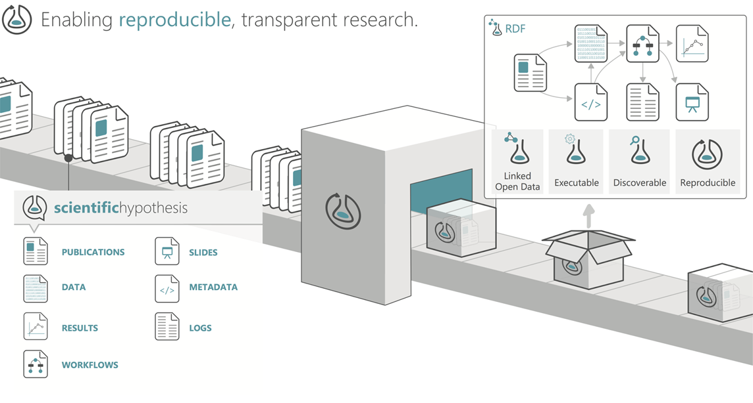
Scientific benchmarking in OpenEBench
Engagement level 3: Participants’ tools execution
RO-Crate is a mechanism to bundle digital objects semantic metadata.
It offers the flexibility of being a single digital object that encapsulates relevant metadata and data (or link to them). The target for workflow executions are the workflow and execution provenance: software containers, input and output datasets (along with their public ids), etc...

Slide 25
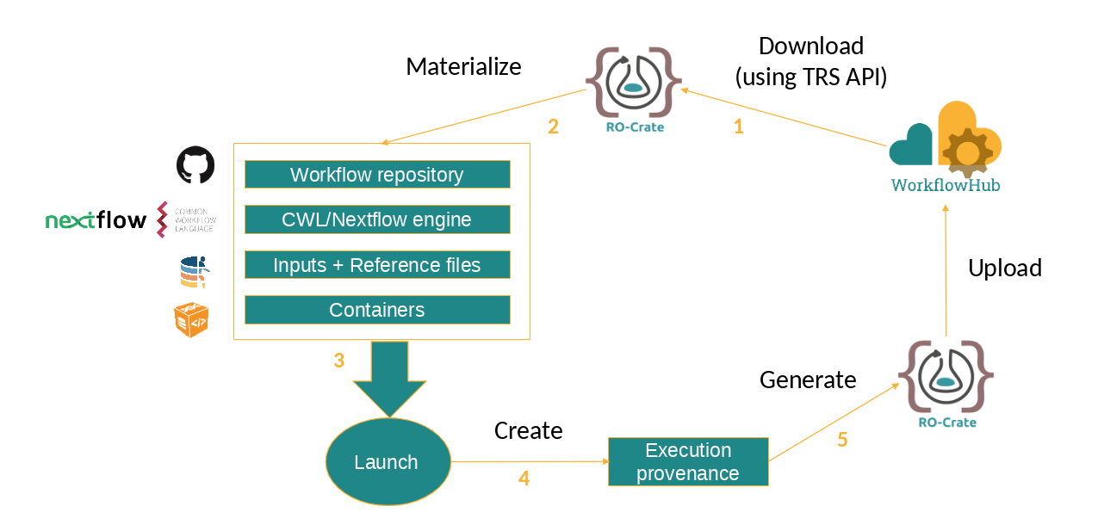
Scientific benchmarking in OpenEBench
Engagement level 3: Participants’ tools execution
Demo case on the execution of the selected workflow https://asciinema.org/a/452404
Back-end engine installation https://asciinema.org/a/452311
Rootless singularity (advanced) https://asciinema.org/a/452320
Workflow execution files (old) https://asciinema.org/a/385268

Slide 26
HANDS-ON EXERCISE 2
Running TCGA workflow with WfExS

Slide 27
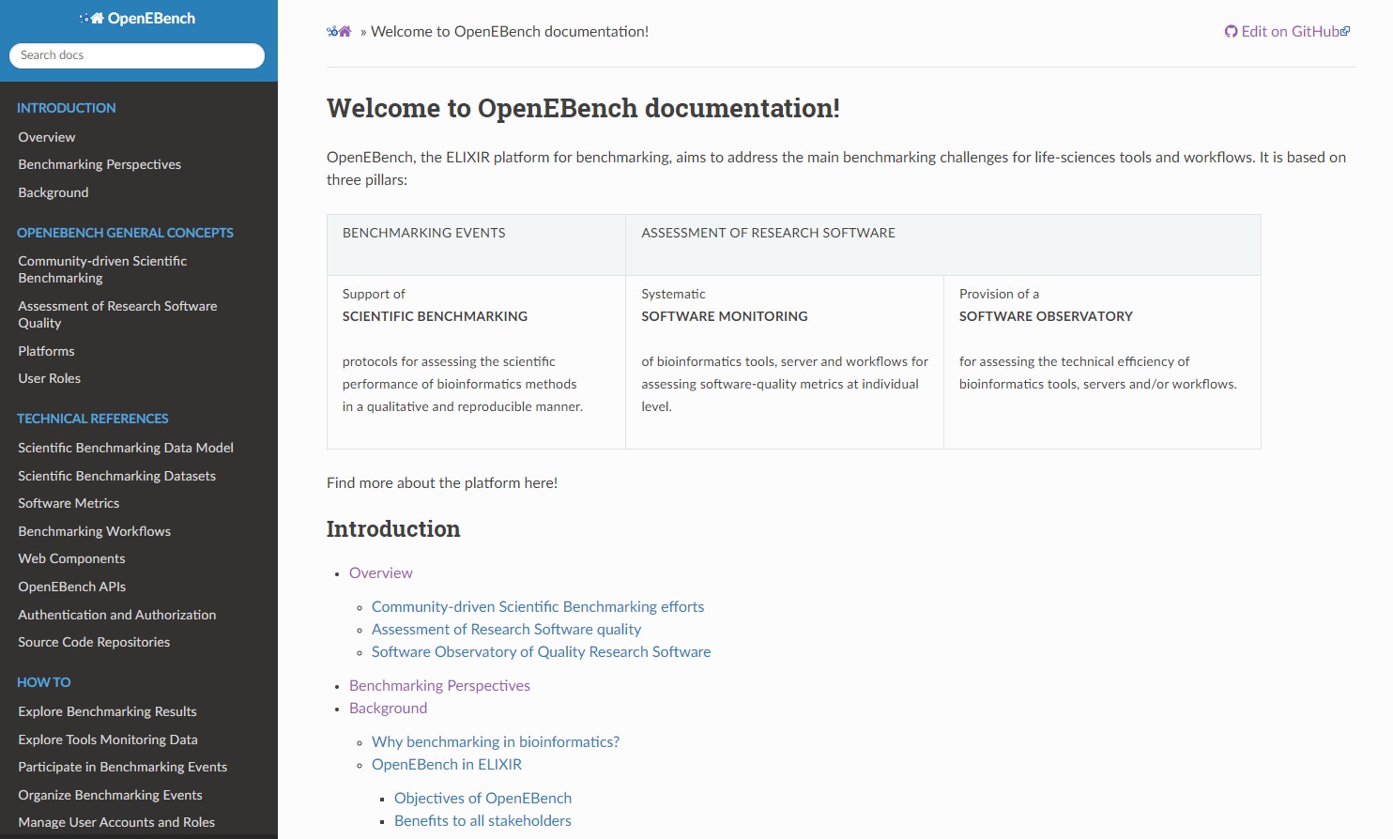
Want to know more about OpenEBench?
Your feedback
is welcome!
https://openebench.readthedocs.io/en/latest/

Slide 28
ACKNOWLEDGEMENTS
Salvador Capella Gutierrez Josep Ll. Gelpi
Laia Codó Dmitry Repchevsky
Txell Ferret Esther Vendrell
Dominik Brüchner
TES
TES
INB/ELIXIR-ES Coordination Team
INB/ELIXIR-ES Computational Team
Reach out to us at openebench-support@bsc.es
Thank you

